Slide 1
Wrangling Your Windows Infrastructure With Ansible
Josh King (@WindosNZ)

Slide 2


Who am I?
Josh King
ToastIT.dev
@WindosNZ
Microsoft MVP
Infrastructure Operations Engineer @ Chocolatey

Slide 3
What’re we talking about today?
Infrastructure as Code
in a Windows environment
Not throwing out your investment in learning PowerShell
Pitfalls and lessons learned
Ansible itself runs on Linux, we won’t be talking about setting up Ansible itself
But reach out afterwards if you have questions

Slide 4








Why Ansible?
Infrastructure Provisioning
Configuration Management
Infrastructure as Code

Slide 5
Terminology
Ansible
PowerShell
Collections
Modules
Roles
Playbooks
Modules
Cmdlets
Functions
Script files

Slide 6
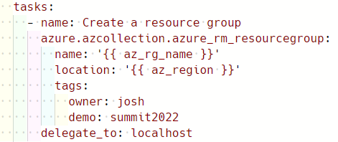
A Note on The YAML
Collection
Module
Task Keywords
{{ variables }}
Module Parameters

Slide 7
DEMO
Let’s spend some money on Azure compute

Slide 8
Key Takeaways
Learn to love YAML
Need WinRM between Ansible host and Windows endpoints
SSH is possible, but it’s experimental
Ansible tends to be Linux first
Make sure you specify Windows when Googling
Sometimes you’ll need to remove the collection name from modules/roles
ansible.windows.win_copy -> win_copy
But other times you’ll need to ensure the collection name is specified 🤦‍♂️

Slide 9
Key Takeaways, continued
Leverage your PowerShell knowledge to plug gaps in existing collections
Aim for idempotence (e.g. only change state if needed.)
Check out James Ruskin’s “Idempotence isn’t a dirty word” talk when recordings are available
Use variables, make your configuration reusable
Jinja2 templates are awesome for reusing templates between prod and dev/test

Slide 10
Next Steps
Capture reusable groups of tasks as roles in a collection
Consider Ansible Tower/AWX
Re-run playbooks periodically to ensure configuration is consistent

Slide 11
Thank You! 💜
Get this slide deck and demo code from:
https://toast.click/Summit2022
Questions? Hit me up on Twitter:
@WindosNZ

